Slide 1
In the name of
Allah

Slide 2
Database Systems I
CSC371
4(3,1)
© Virtual University of Pakistan

Slide 3
Lecture Overview
Course Objectives
Importance of course
What is a database
Limitations of conventional file processing
Advantages of databases

Slide 4
Course Objectives
© Virtual University of Pakistan

Slide 5
Importance of Course
© Virtual University of Pakistan

Slide 6
What is a Database
© Virtual University of Pakistan

Slide 7
Database Def-1
A database is a shared collection of logically related data, usually designed to meet the information needs of different users in an organization.
© Virtual University of Pakistan

Slide 8
Database Def-2
A database is a self-describing collection of integrated records
© Virtual University of Pakistan

Slide 9
Database Def-3
Organized collection of logically related data in which redundancy is minimum.
Examples:
    NADRA Database
    University Database

Slide 10
Example
Student
Rno | Sname | Age | City
1 | Haseeb | 20 | SWL
2 | Ali | 21 | LHR
Phones
Rno | Ph No
1 | 04022222
1 | 04032323
2 | 04254545

Slide 11
Database Management System (DBMS):
  A software that is used to create, maintain and provide controlled to user databases.
  A software that handles all access to the database
  A software that is responsible for applying the authorisation checks and validation procedures
  Ex: Oracle, SQL Server, MySQL, MS Access

Slide 12
Database Application:
  An application program (or set of related programs) that is used to perform a series of database activities (create, read, update, and delete)

Slide 13
A bit of History
Computer initially used for computational/ engineering purposes
Commercial applications introduced File Processing System
© Virtual University of Pakistan

Slide 14
File Processing System
A collection of programs that perform services for the end-users such as the production of reports. Each program defines and manages its own data
© Virtual University of Pakistan

Slide 15
File Processing Systems
Library
Examination
Registration
Library
Applications
Examination
Applications
Registration
Applications
Library
Data
Files
Examination
Data
Files
Registration
Data
Files
© Virtual University of Pakistan

Slide 16
File Processing Systems
Library
Examination
Registration
Reg_Number
Reg_Number
Reg_Number
Name
Name
Name
Father Name
Address
Father Name
Books Issued
Class
Phone
Fine
Semester
Address
Grade
Class
Duplication of Data
Vulnerable to Inconsistency
© Virtual University of Pakistan

Slide 17
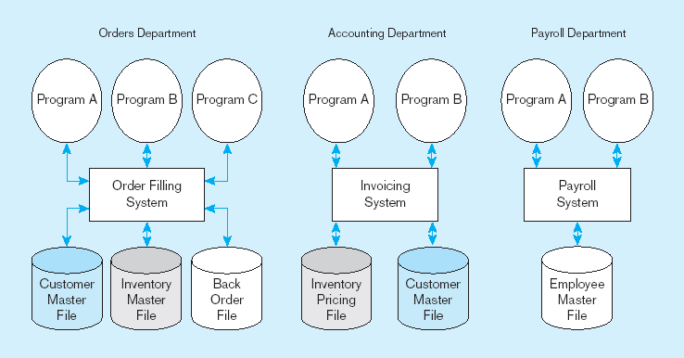
Figure 1-3 Old file processing systems at Pine Valley Furniture Company
Duplicate Data

Slide 18
Disadvantages of File Processing
Program-Data Dependence
  All programs maintain metadata for each file they use
Duplication of Data
  Different systems/programs have separate copies of the same data
Limited Data Sharing
  No centralized control of data
Lengthy Development Times
  Programmers must design their own file formats
Excessive Program Maintenance
  80% of information systems budget

Slide 19
Problems with Data Dependency
Each application programmer must maintain his/her own data
Each application program needs to include code for the metadata of each file
Each application program must have its own processing routines for reading, inserting, updating, and deleting data
Lack of coordination and central control
Non-standard file formats

Slide 20
Problems with Data Redundancy
Waste of space to have duplicate data
Causes more maintenance headaches
The biggest problem:
  Data changes in one file could cause inconsistencies
  Compromises in data integrity

Slide 21
SOLUTION:
The DATABASE Approach
Central repository of shared data
Data is managed by a controlling agent
Stored in a standardized, convenient form
Requires a Database Management System (DBMS)

Slide 22

Advantages of Database Approach
Library
Examination
Registration
Library
Applications
Examination
Applications
Registration
Applications
Database
Management
System
- Data Sharing
University
Students
Database
- Data Independence
- Controlled Redundancy
- Better Data Integrity
© Virtual University of Pakistan

Slide 23
Database Management System
A software system that is used to create, maintain, and provide controlled access to user databases
Order Filing
System
Central database
Contains employee,
order, inventory,
pricing, and
customer data
Invoicing
System
DBMS
Payroll
System
DBMS manages data resources like an operating system manages hardware resources

Slide 24
Advantages of the Database Approach
Program-data independence
Planned data redundancy
Improved data consistency
Improved data sharing
Increased application development productivity
Enforcement of standards
Improved data quality
Improved data accessibility and responsiveness
Reduced program maintenance
Improved decision support

Slide 25
Other Advantages
Better data security
Improved data standards
Better data accessibility
Better control concurrency
Better backup and recovery procedures
© Virtual University of Pakistan

Slide 26
BUT
Its not always just
the
SUGAR
© Virtual University of Pakistan

Slide 27
Costs and Risks of the Database Approach
Higher costs: New, specialized personnel
Installation and management cost and complexity
Conversion costs
Need for explicit backup and recovery

